Slide 1
Magically integrating external data

Slide 2
Please stand up
I want to know you

Slide 3

Hands up in the air
A little higher please

Slide 4
Spread arms to indicate how old you feel
Wider is older, your mileage may vary

Slide 5
Add or substract your umbraco knowlege
Go wider or narrower - I know this is very subjective

Slide 6

STAND STILL
And please smile FFF!

Slide 7
Damiaan Peeters
Since v4 umbraco at Umbrace
Documentation Curator & Mvp 2018
Magician in my free time
Antwerp, Belgium
@dampeebe
damiaan@umbrace.be

Slide 8
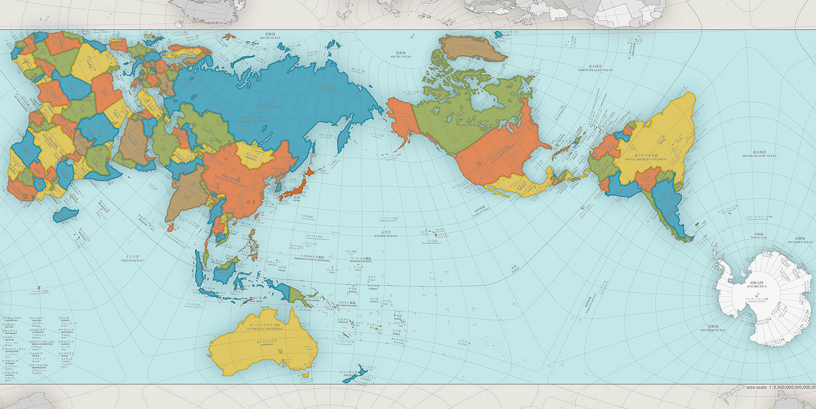
Belgium?

Slide 9




Umbrace

Slide 10
Agenda
Story
Different scenarios
Technical examples (.net code)

Slide 11

A story about integration
Notes:
A story about integration

Slide 12
Where does the data stay?
Import vs external source

Slide 13

Importing into umbraco
Some data going into your umbraco
Umbraco content or media nodes

Slide 14
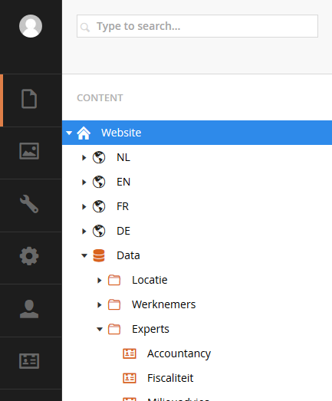

Slide 15
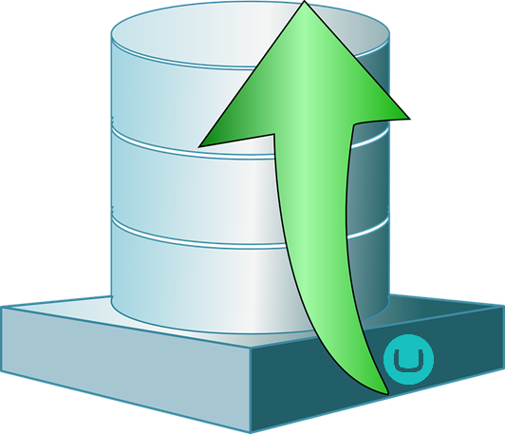
Data from external source
Some external data store
Your Umbraco

Slide 16
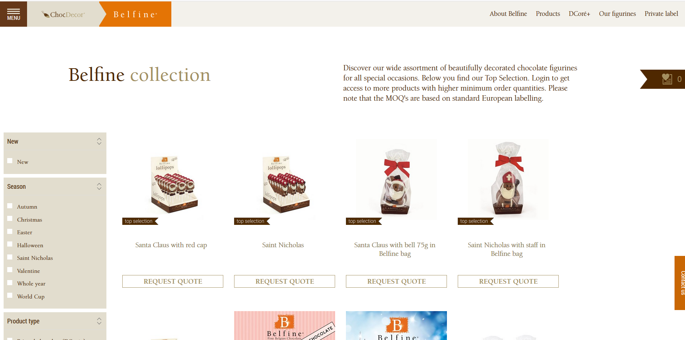
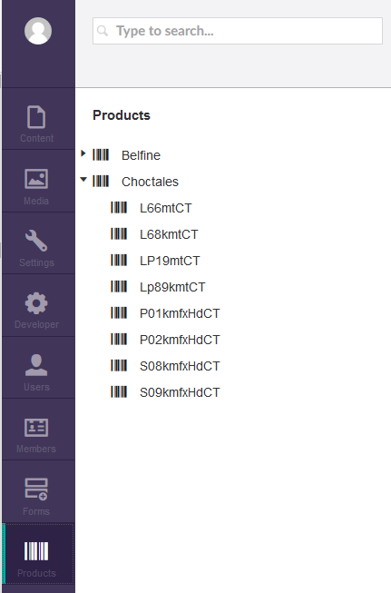
Database

Slide 17
External data store
Same database as Umbraco but different database tables
Another database
NoSql datastore
API’s across the internets

Slide 18
Import vs External
Advantages and disadvantages

Slide 19
Importing data in the CMS
PRO
Data is available in properties
Fast to show
Easy access for front-end devs
CONs
Unsuitable for regular updates
Dev time for import service

Slide 20
External sources
PRO
Suited for big amounts of data
CONs
Possible lags on network resources
More development

Slide 21
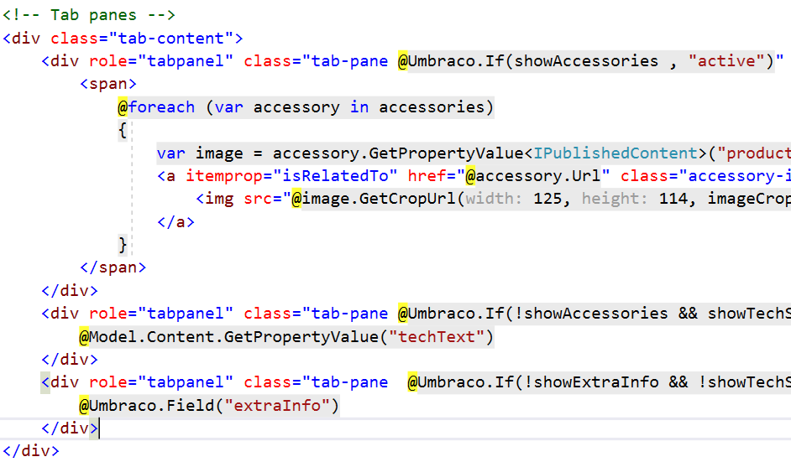
Import (pro’s)
Easy front end dev
Fast rendering
Easy backend updates by the content editors
Notes:
Data is available in properties
Fast to show
Easy access for front-end devs

Slide 22

External (pro’s)
NASA From "Pursuit of Light" - Perpetual Ocean
This image shows the currents and channels of the world’s oceans.
Use real time data
Updates via other sources
Appropriate data store (noSql, Api, signalR, …)
Really big amounts of data
Not adaptable by Content Editor

Slide 23

Import (caveats)
Unsuitable for regular updates
Slow
Dev time for import service

Slide 24

External (caveats)
KEEP
CALM
and
IGNORE THE TROLLS
More dev time
Think about architecture
Have a fallback / error page
(network lags, cache, …)
Notes:
ARCHITECTURE :
how to integrate inside the back-end
How to do caching
FALLBACK / ERROR PAGE
Network lag
Resource unavailable

Slide 25
Import versus External
 | PRO’s | CON’s
Import | Easy access via Umbraco code | Slow updates & limited amount of data
External sources | Flexibility | development complexity

Slide 26
Demo

Slide 27
Importing explained
… just one of the zillion options

Slide 28
Triggers for importing data
On a click, after an event eg publish, …
After user interaction E.g. a dashboard
Scheduled process On a ad hoc regular basis
Webhook implementation Some other process calls your api
Umbraco Scheduled tasks, Hangfire, quarz
UmbracoApiController

Slide 29
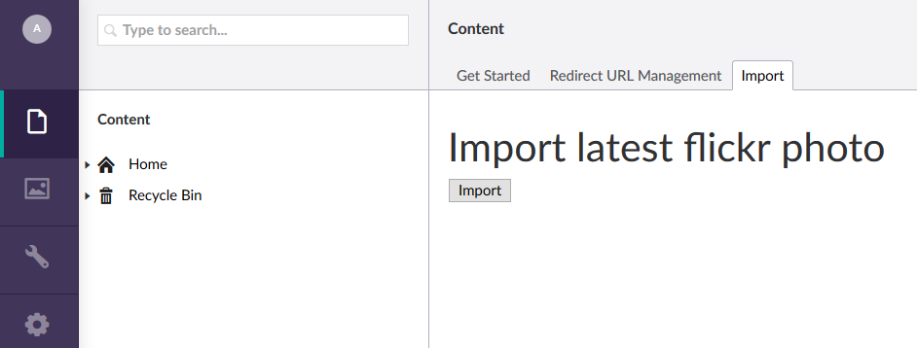
Create a dashboard
https://our.umbraco.org/documentation/Tutorials/Creating-a-Custom-Dashboard/

Slide 30
Edit /config/dashboard.config
<section alias="Import Dashboard">
<access>
<deny>translator</deny>
</access>
<areas>
<area>content</area>
</areas>
<tab caption="Import">
<control> /app_plugins/ImportDashBoard/index.html
</control>
</tab>
</section>

Slide 31
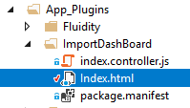
Create a plugin
https://our.umbraco.org/documentation/Tutorials/Creating-a-Property-Editor/

Slide 32
Call the backend code
UmbracoAuthorizedApiController Call via angularjs
UmbracoAuthorizedController
/// <remarks>
/// When using UmbracoAuthorizedController we need to register the routes
/// </remarks>
public class ImportController : UmbracoAuthorizedController
{
[HttpPost]
public string ProcessImportData(string immediate)
{

Slide 33
ApplicationContext.Services
public class FlickrImportService : IImportService
{
public bool AddDummyContent(StringBuilder sb)
{
Flickr flickr = new Flickr("93d4b479487d79846186bf81486e1934");
var options = new PhotoSearchOptions { PerPage = 1, Page = 1 };
options.Tags = "colorful";
var photo = flickr.PhotosGetRecent(1, 1).FirstOrDefault();
// add media item
var mediaService = ApplicationContext.Current.Services.MediaService;
var newmedia = mediaService.CreateMediaWithIdentity(photo.Title, -1, "image");
var destinationFolder = HostingEnvironment.MapPath("~/App_Data/FlickrTemp/");
System.IO.Directory.CreateDirectory(destinationFolder);
var newFileName = Path.Combine(destinationFolder, photo.PhotoId + ".jpg");
new WebClient().DownloadFile(photo.LargeUrl, newFileName);
var s = new FileStream(newFileName, FileMode.Open);
newmedia.SetValue("umbracoFile", Path.GetFileName(newFileName), s);
s.Close();
mediaService.Save(newmedia);
// bad code, should use repository
var productsNode = UmbracoContext.Current.ContentCache.GetSingleByXPath($"//{PublishedContentModels.Products.ModelTypeAlias}");
var contentService = ApplicationContext.Current.Services.ContentService;
var newNode = contentService.CreateContentWithIdentity(photo.PhotoId, productsNode.Id,
PublishedContentModels.Product.ModelTypeAlias);
newNode.SetValue("description", "flickr description: " + photo.Description ?? "none");
newNode.SetValue("photos", $"{newmedia.GetUdi()}");
Random rand = new Random();
newNode.SetValue("price", rand.Next(1, 1000));
newNode.SetValue("category", "flickr");
newNode.SetValue("productName", photo.Title);
contentService.SaveAndPublishWithStatus(newNode);
sb.Append("imported most recent photo from flickr: " + photo.Title);
return true;
}
}

Slide 34
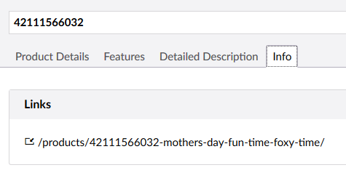
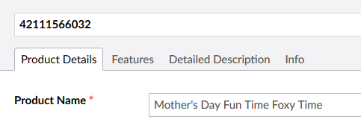
Update Url for SEO

Slide 35
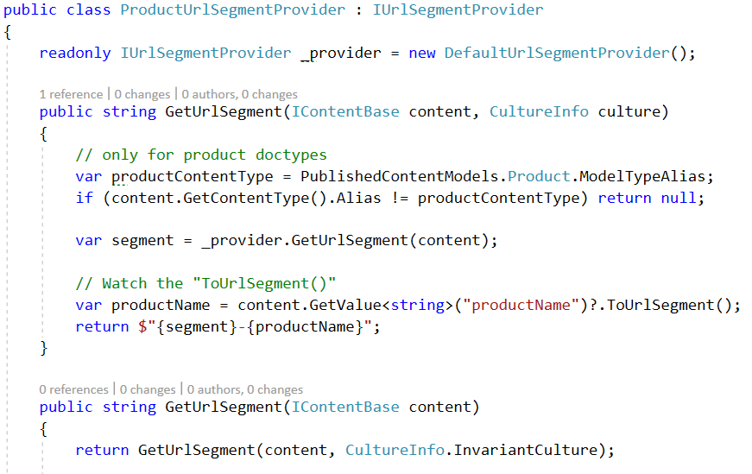
Use UrlSegmentProvider

Slide 36
UrlSegmentProvider - wireup
public class ProductUrlSegmentEvents : ApplicationEventHandler
{
protected override void ApplicationStarting(
UmbracoApplicationBase umbracoApplication,
ApplicationContext applicationContext)
{
UrlSegmentProviderResolver
.Current.InsertType<ProductUrlSegmentProvider>(0);
}
}

Slide 37
External data explained

Slide 38
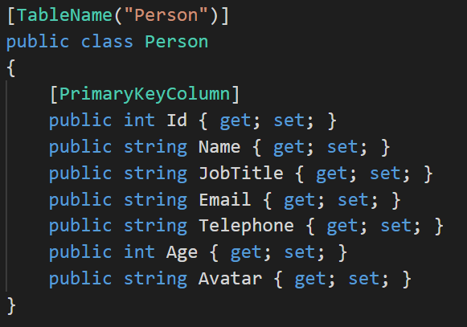
A POCO user object
https://umco.github.io/umbraco-fluidity/overview/getting-started/

Slide 39
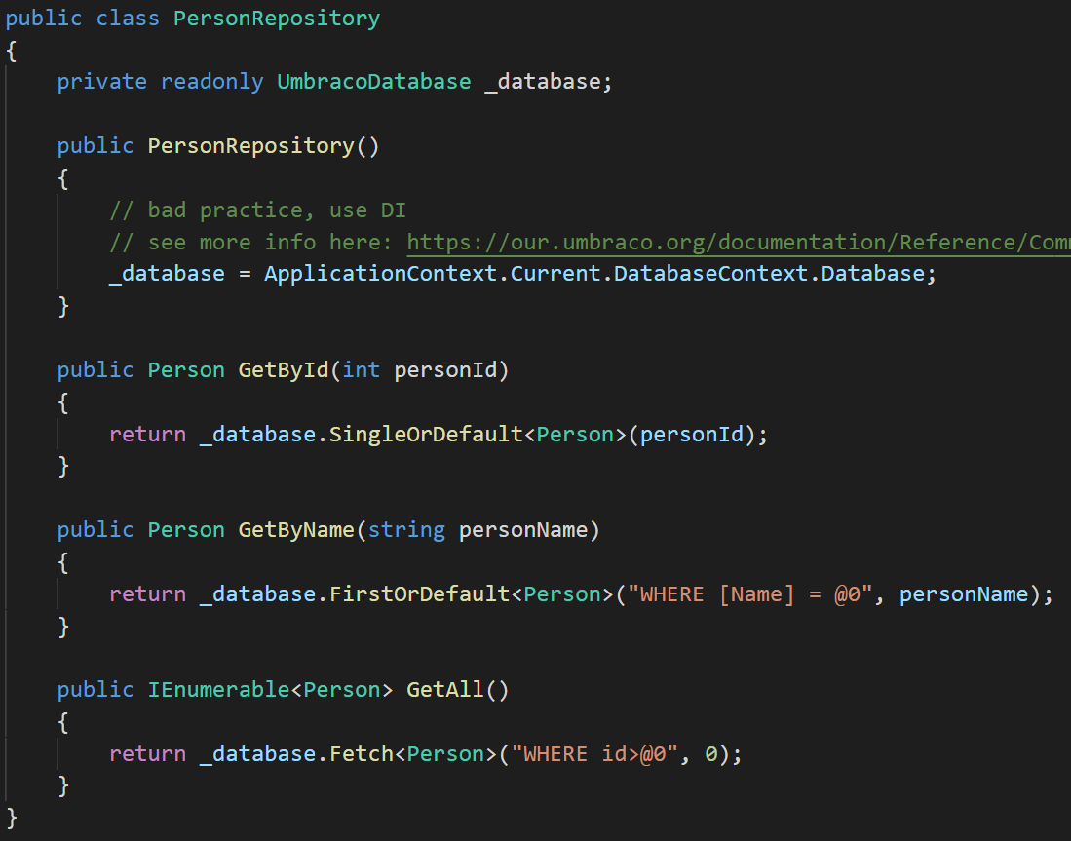
A repository
Note about usage of singletons:
https://our.umbraco.org/documentation/Reference/Common-Pitfalls/#usage-of-singletons-and-statics

Slide 40
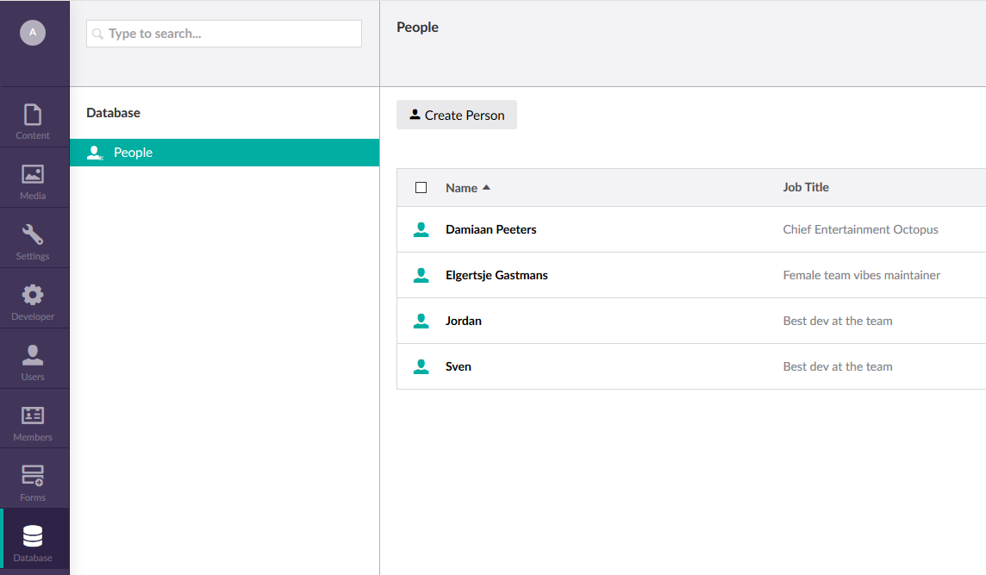
Editing the backend data
Using fluidity package (thanks Umco guys!)
www.patreon.com/umco

Slide 41
Render external data
SurfaceController
RenderMvcController

Slide 42
SurfaceController
First approach for external data

Slide 43
Surface Controllers
https://our.umbraco.org/Documentation/Reference/Routing/surface-controllers
A SurfaceController is an MVC controller that interacts with the front-end rendering of an UmbracoPage. They can be used for rendering MVC Child Actions and for handling form data submissions. SurfaceControllers are auto-routed meaning that you don't have to add/create your own routes for these controllers to work.

Slide 44
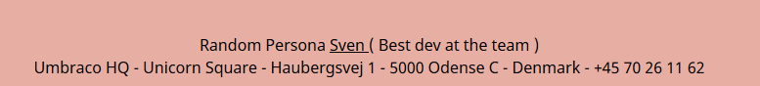
Surface controller

Slide 45
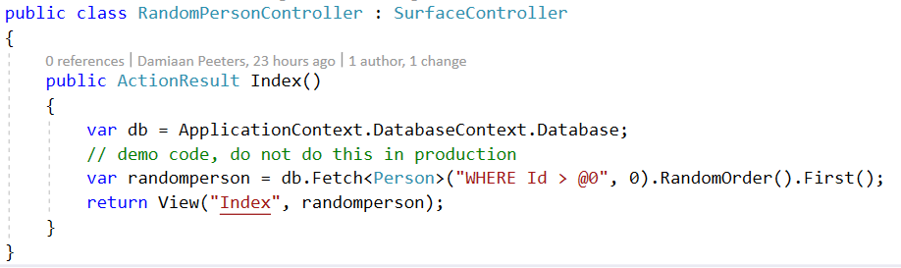
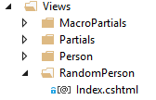
External source – Surface controller
Random fetch from database

Slide 46
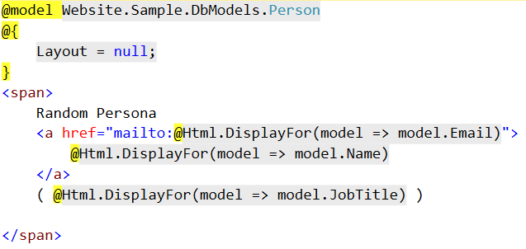
SurfaceController – the partial

Slide 47
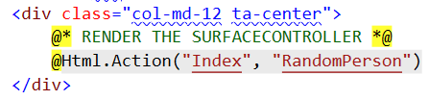
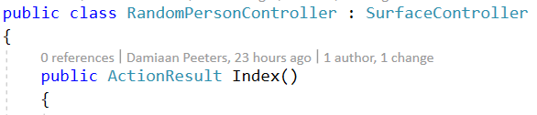
Rendering a SurfaceController
can be used for rendering MVC Child Actions

Slide 48

Surface controller
Result

Slide 49
RenderMvcController
Second approach for external data

Slide 50
Custom controllers (Hijacking Umbraco Routes)
If you need complete control over how your pages are rendered then Hijacking Umbraco Routes is for you
By default all of the front end routing is executed via the Umbraco.Web.Mvc.RenderMvcController Index Action
https://our.umbraco.com/documentation/reference/routing/custom-controllers

Slide 51
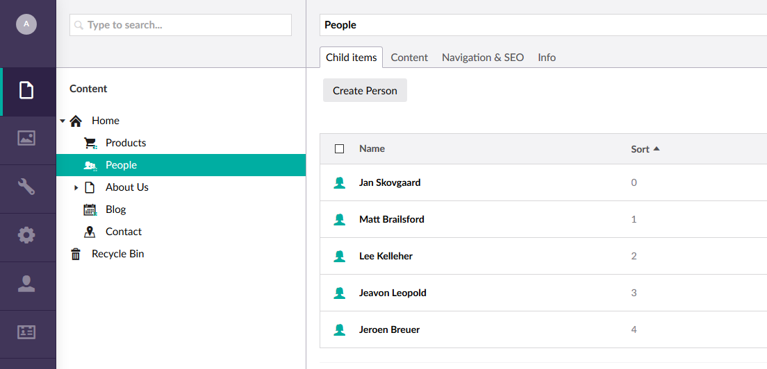

Slide 52
RenderMvcController
THE DOCUMENT TYPE

Slide 53
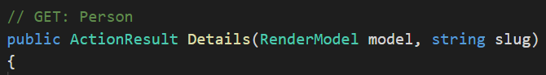
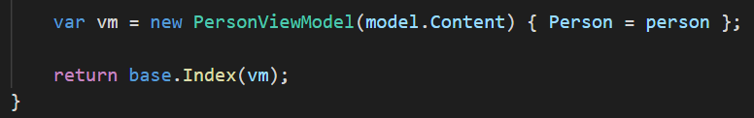
RenderMvcController – the important parts
THE TEMPLATE NAME
TIP: If you use public override ActionResult Index(…), the template from the node is used
TIP2: Don’t forget to add the templates in the umbraco backoffice

Slide 54
RenderMvcModel – the viewmodel
public class PersonViewModel : RenderModel
{
public PersonViewModel(IPublishedContent content, CultureInfo culture) : base(content, culture)
{
}
public PersonViewModel(IPublishedContent content) : base(content)
{
}
public Person Person { get; set; }
}

Slide 55
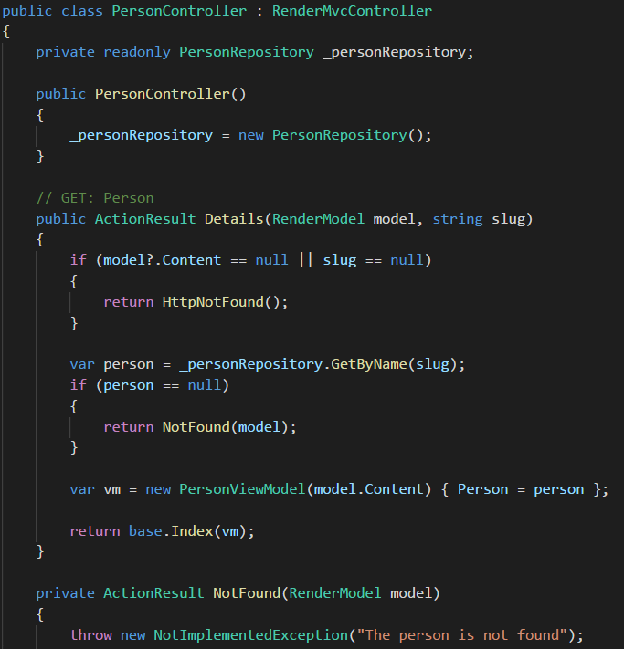
RenderMvcController

Slide 56
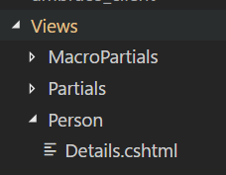
Person / Details.cshtml View
@inherits Umbraco.Web.Mvc.UmbracoViewPage<Website.Sample.ExternalData.PersonViewModel>
@{
ViewBag.Title = "View";
Layout = "~/Views/Master.cshtml";
var breadCrumbNodes = new[] {Model.Content.Parent.Name, Model.Content.Name};
var image = Model.Person.Avatar;
}
@Html.Partial("~/Views/Partials/SectionHeader.cshtml")
<div>
@breadCrumbNodes
</div>

Slide 57
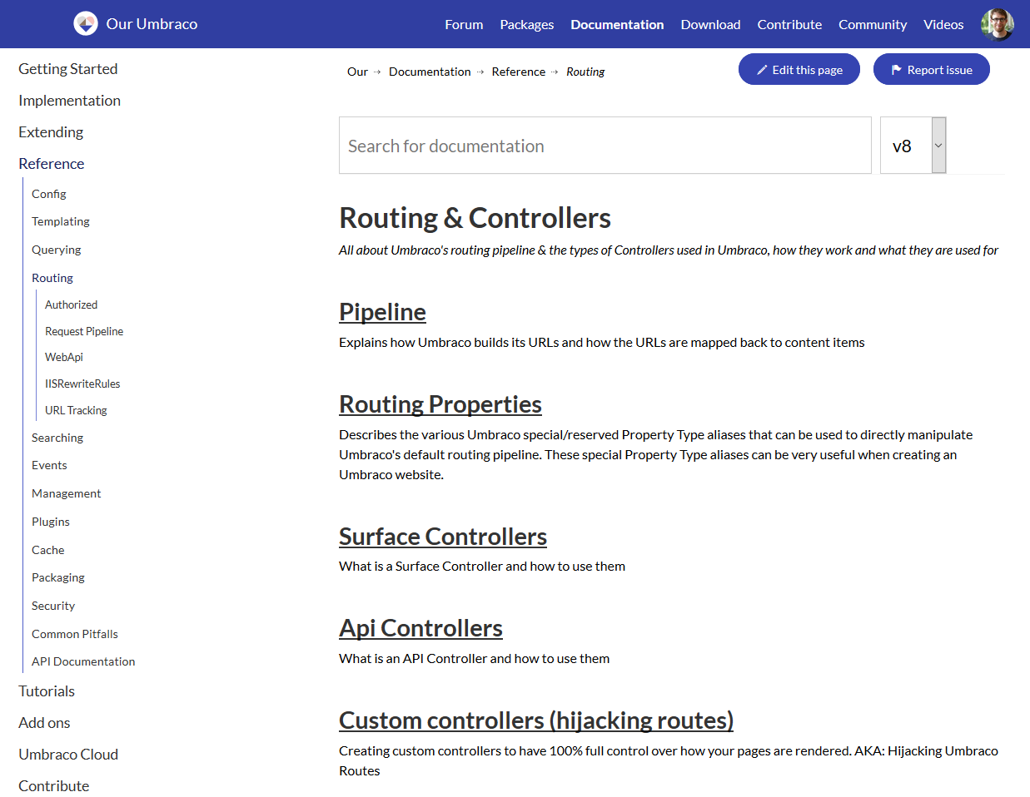
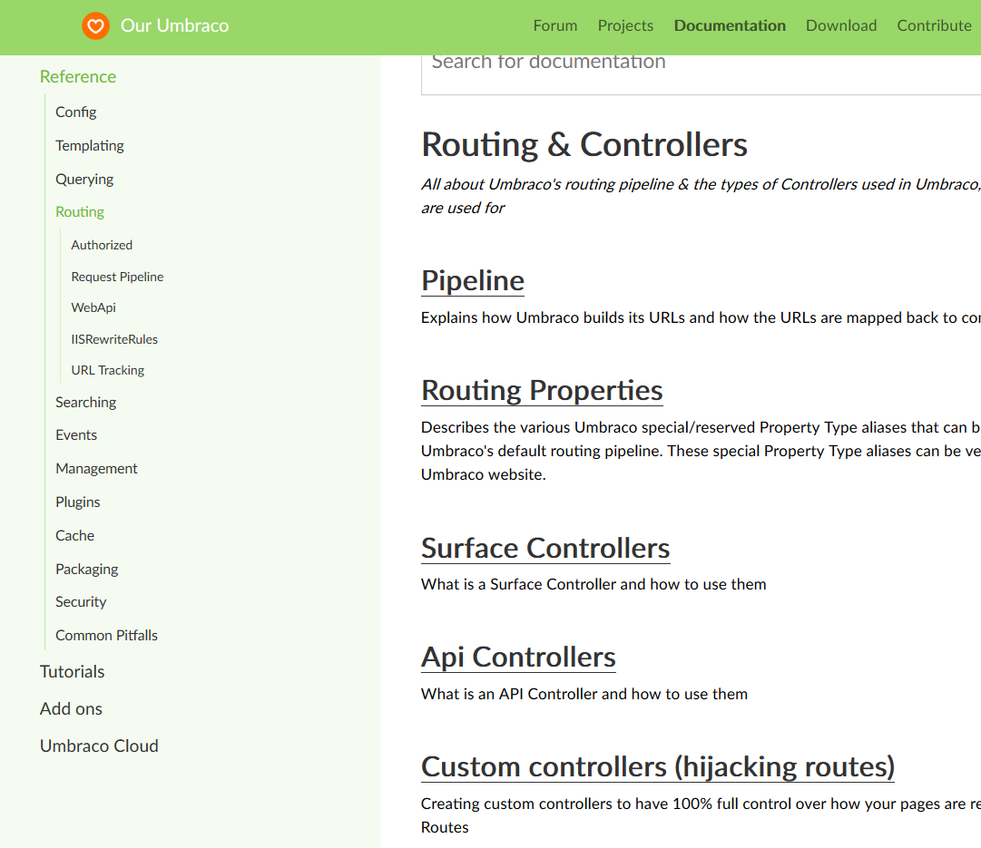
https://our.umbraco.org/documentation/reference/routing/custom-controllers

Slide 58
Messing with Mvc Routes
… and still using umbraco

Slide 59
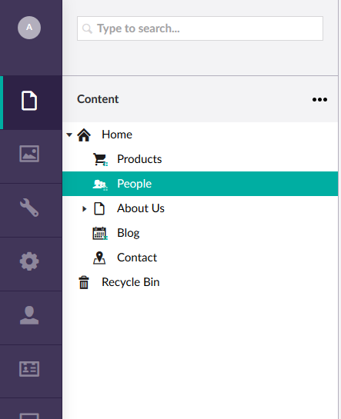
HOST OUR SQL RECORDS
Managed by Umbraco

Slide 60
Handling routes in Umbraco
ContentFinder find the right node for this Url
UrlProvider provide an url for a particular node
VirtualNodeRouteHandler Use a node for your custom mvc route

Slide 61
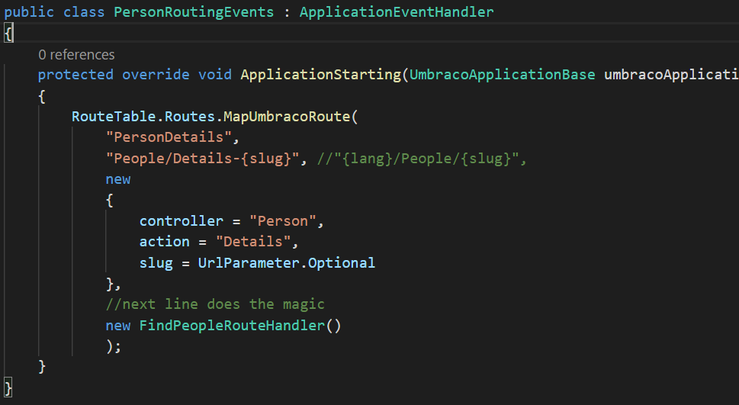
Use the VirtualNodeRouteHandler

Slide 62
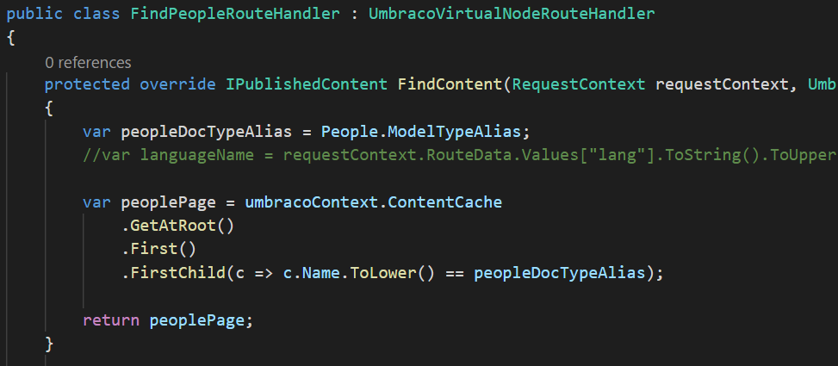
VirtualNodeRouteHandler

Slide 63
It works. But what happened exactly?
RouteTable
VirtualNodeRouteHandler
RenderMvcController
Show view
ViewModel

Slide 64
Show SQL data
By extending umbraco with RenderMvcController
With all umbraco power still available

Slide 65
Inject data on inbound pipeline
Bonus approach

Slide 66
Inject data with inbound pipeline
Create the properties you need on your Document Type
Hide tab for editor with EditorModelEventManager.SendingContentModel
Use PublishedContentRequest.Prepared to inject database content from properties
Write content finders
Models injected could to implement IPublishedContent

Slide 67


Bonus Approach
Front-end can use models builder for database data (e.g. easy breadcrumbs)
You can store Umbraco content in external data store
More code to write
Shout out to https://twitter.com/dawoe21

Slide 68
Approach of external source
EXTEND UmbracoRenderMvc or use SurfaceController
Create model
Use cache
Content finder & UrlProvider

Slide 69
A few tips

Slide 70
Routing done right
Learn RenderMvcController not only for external data
UrlProvider & ContentFinder to find the node and create a url (e.g. swap homepage)
UrlSegmentProvider = SEO dope
SurfaceController for child actions or custom forms
https://our.umbraco.org/documentation/Reference/Routing/Request-Pipeline/

Slide 71
Import will go wrong…
ContentService is slow
Use request throttling if (multiple) sources are pushing data to your api
Do not use relationship api for relationships between more than 2 nodes
Do not make a generic import api to update any doctype you can think of

Slide 72
Performance tips
Investigate ExamineDb Simple solution to index and search databases using Examine https://github.com/rsoeteman/ExamineDB
Don’t write your own caching layer Use ApplicationContext.ApplicationCache.RuntimeCache (happier when loadbalancing with ICacheRefresher)

Slide 73

Caching is not the solution
Notes:
Imports can slow down your site (content service)

Slide 74

Caching is not the solution
An old man without a stick is still an old man
Notes:
It’s not because you take the walking stick from the old man, that he will run faster
The walking-stick reaches many lands, the word many more.

Slide 75
Use Xpath and Examine to optimize But in a thoughtfull way
Don’t abstract umbraco away Don’t derive baseclasses, it will probably bloat your model passed into your view (and slow down your site)

Slide 76
Resources

Slide 77
Packages to explore
UI-O-Matic Auto generate an integrated crud UI in Umbraco for a db table based on a petapoco poco and more! https://our.umbraco.org/projects/developer-tools/ui-o-matic/
Fluidity Fluidity is a rapid Umbraco user interface builder for custom data structures configured via a fluent API. https://our.umbraco.org/projects/backoffice-extensions/fluidity/
CMS Import CMSImport PRO helps you import content or members from any datasource into Umbraco. https://our.umbraco.org/projects/developer-tools/cmsimport

Slide 78
Download the code?
https://github.com/dampee/Umbraco-IntegratingData
V7 + v8

Slide 79



Slide 80

Questions?
Emphasizes your point

Slide 81

Thank you.

